Slide 1
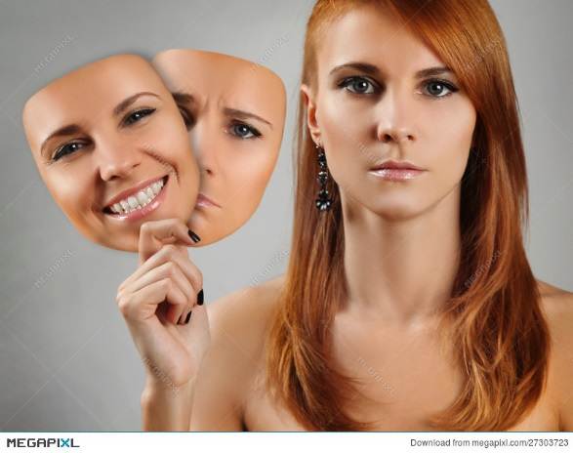
Intro to Polymorphism
Many Forms

Slide 2
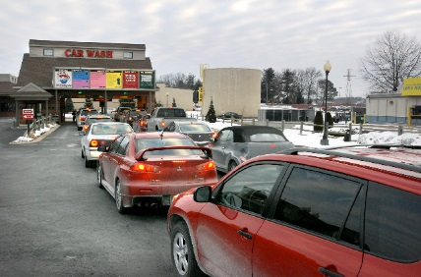
Let’s Consider a Car Wash
Program to an interface, not an implementation
What is the interface to the car wash (i.e. what are its inputs and outputs)
Inputs: Dirty car
Outputs: Clean car
Note: The car is modified; we don’t destroy the input and create the output

Slide 3
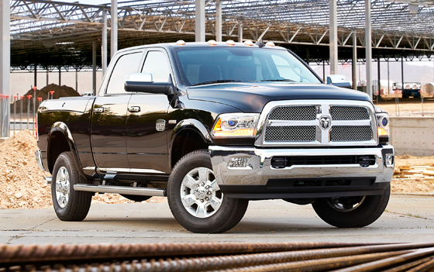
But I don’t drive a car…
Can I go to the “car” wash?
Strictly speaking (strongly typed) I cannot
What if I do anyway?

Slide 4
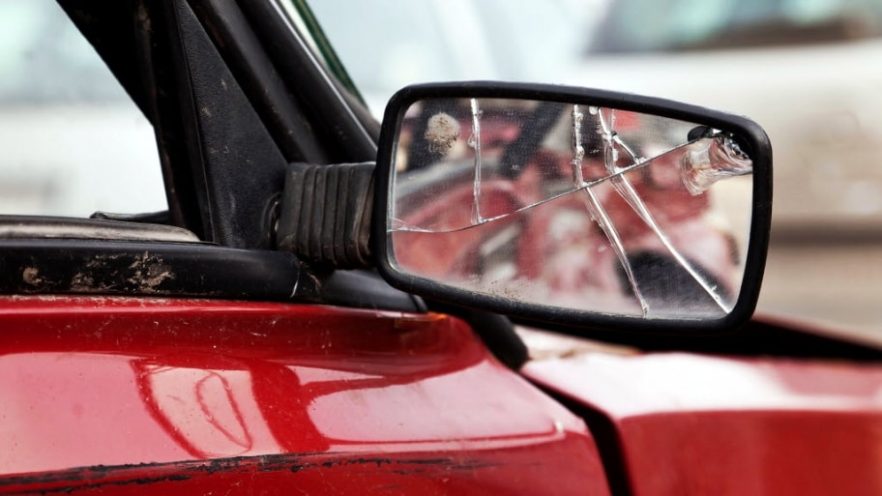
Ouch…
Maybe I don’t want to go to the “car” wash
Perhaps I am looking for a “vehicle” wash

Slide 5

Or am I?
Thinking through corner cases matters
I don’t think I’d be happy taking my bike through the “vehicle” wash
Awesome dirt bike trail I found in Southern Utah

Slide 6
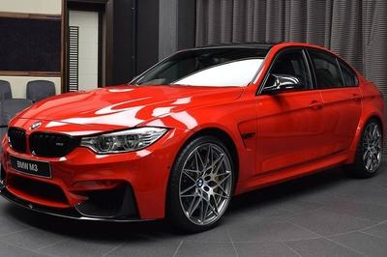
Is there some amount of commonality between our vehicles?
They all have wheels

Slide 7
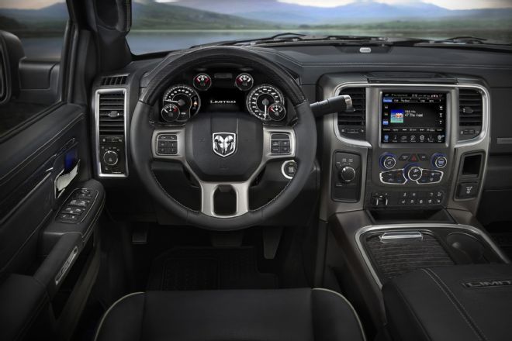
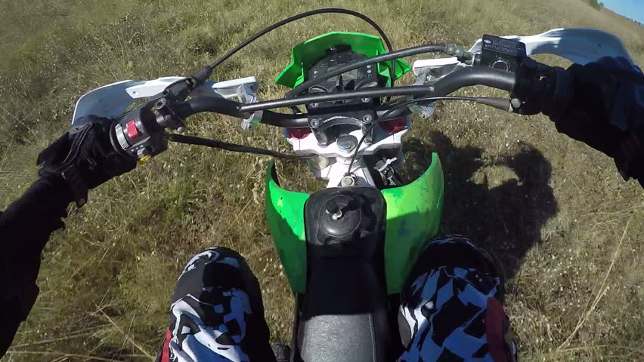
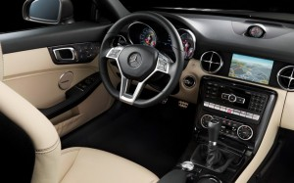
Is there a common interface but a distinct implementation?
No clutch; auto trans
They all drive
Clutch on the left hand
Floor clutch; manual trans

Slide 8
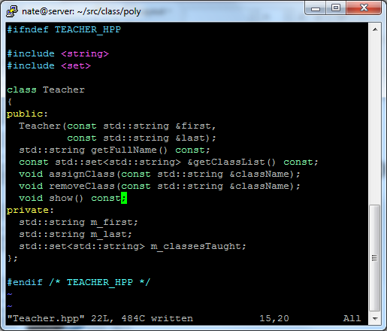
Let’s write some code!
The header is our interface; start there
Build a class/object to encapsulate a Teacher
What members should it have?
What methods should it have?
We can implement this, compile it, and test
Volunteers to code real-time

Slide 9
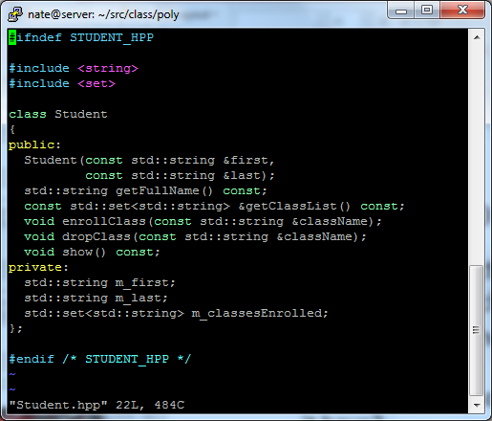
Don’t forget the student!
Do you see the commonality, difference, and interface
Build a class/object to encapsulate a Student
What members should it have?
What methods should it have?
We can implement this, compile it, and test
Volunteers to code real-time

Slide 10
Evil, Bad, Rotten Code – Let’s count the ways this was dumb…

Slide 11
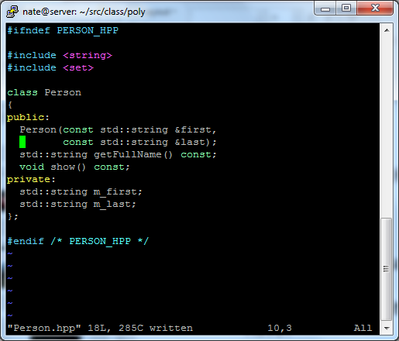
Factor out the common code!
Remember the magic that is inheritance
Build a base class/object to encapsulate a Person
What common members should it have?
What common methods should it have?
We can implement this, compile it, and test
Volunteers to code real-time

Slide 12
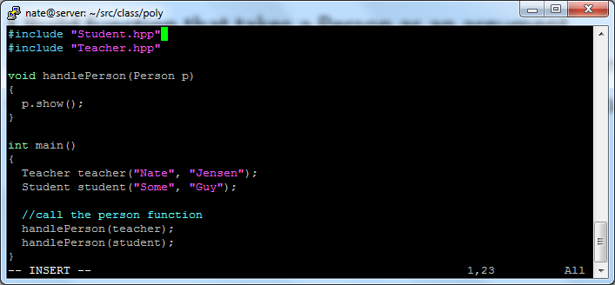
Both Student and Teacher “is a” person – they can be compatible
What does this do? Which show method gets called?

Slide 13
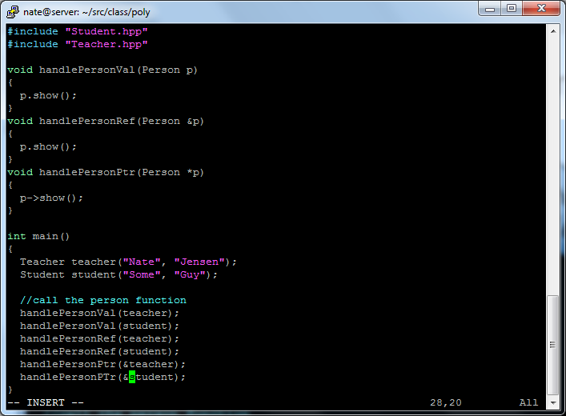
Does changing the signature of the function alter the behavior?
What does this do? Which show method gets called?

Slide 14
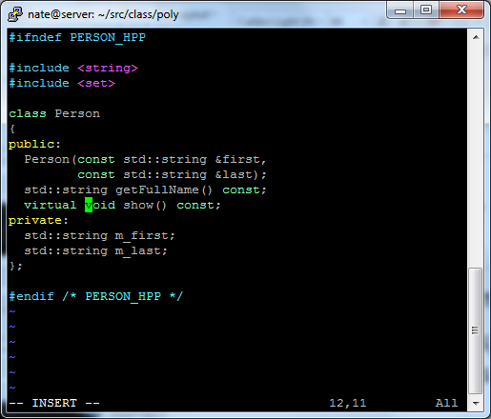
Here’s a new C++ keyword
Change the show method to be virtual
Change *nothing* else and repeat the previous exercise
What happened this time?
Change the prototype in the base class

Slide 15
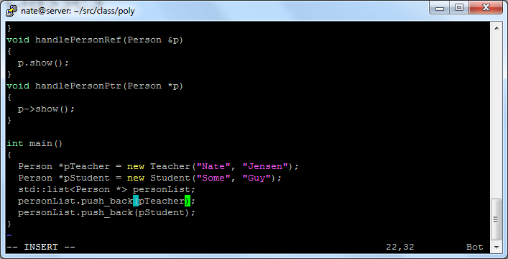
Pointers to base classes can point to derived classes
I can have a collection of ptrs to objects that are of different types. What happens when I call show on pointers in this list?

Slide 16
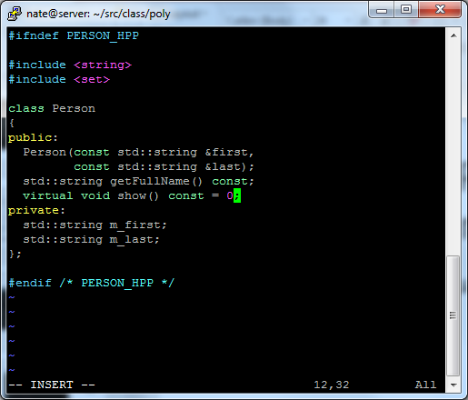
Can I have a Person that is neither a Student nor a Teacher
This is called a “pure” virtual. It means:
A derived/concrete class must override this function
A person object cannot be instantiated
A class with one or more pure virtuals is called abstract

